Slide 1

WELCOME BACK
TO THE
JUNIOR HIGH

Slide 2
JUNIOR HIGH:
AN OVERVIEW

Slide 3
WEIGHTING FOR ALL JUNIOR HIGH SUBJECTS
HOMEWORK 10%
TEST 40%
QUIZ 25%
CLASSWORK 25%

Slide 4
ALL JUNIOR HIGH STUDENTS WILL START THE DAY WITH A SPECIAL FROM 7:50-8:30 MONDAY, TUESDAY, THURSDAY, AND FRIDAY.
IT IS IMPORTANT FOR THE STUDENTS TO EAT BREAKFAST-especially on WEDNESDAYS!!
IF YOU NEED TO GIVE YOUR CHILD A MESSAGE ABOUT PICK UP OR CHANGES IN APPOINTMENTS, PLEASE EMAIL THE HOMEROOM TEACHER BY 8:30. AFTER 8:30 EMAIL/CALL MRS. PEREZ AT THE FRONT DESK

Slide 5
BIRTHDAYS: Each student will receive a birthday treat on his/her birthday-please do not send in treats for the class

Slide 6
SO YOU WANT EXTRA CREDIT…
HOW ABOUT DOING ALL OF THE REGULAR CREDIT!

Slide 7


Slide 8
Accountability
Be prepared and ready to learn
Represent your school well at all times (online too!)

Slide 9
Respect
Respect school property, facilities, and people’s belongings
Respect all students and teachers
Respect people’s opinions and contributions
Accept instructions from all faculty and staff

Slide 10
Consideration
Follow all uniform/free dress policies
Use proper language
Listen without interruption
Be considerate and appreciate volunteers/campus visitors

Slide 11
Honesty
Be honest at all times
Do your own work

Slide 12
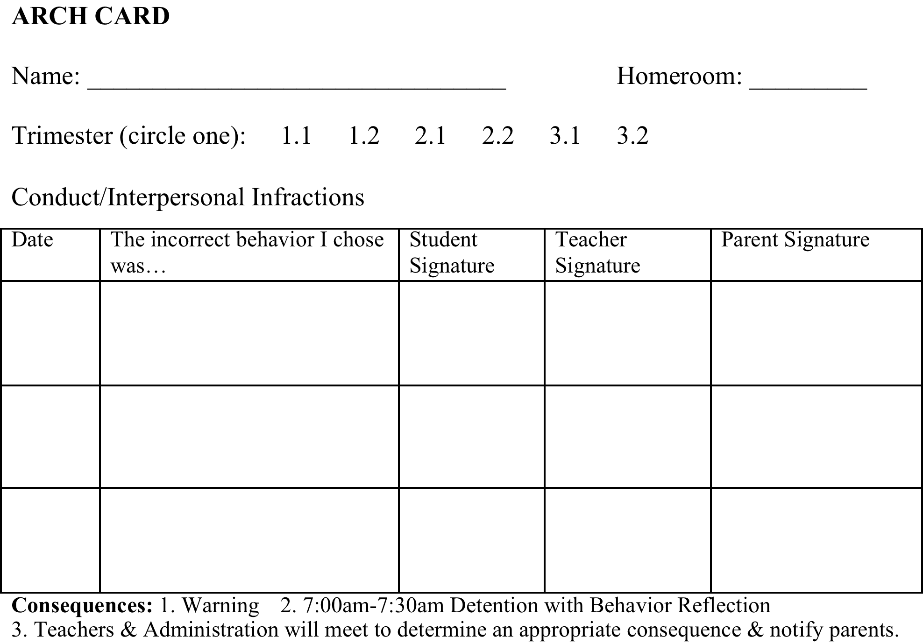
FRONT OF CARD

Slide 13
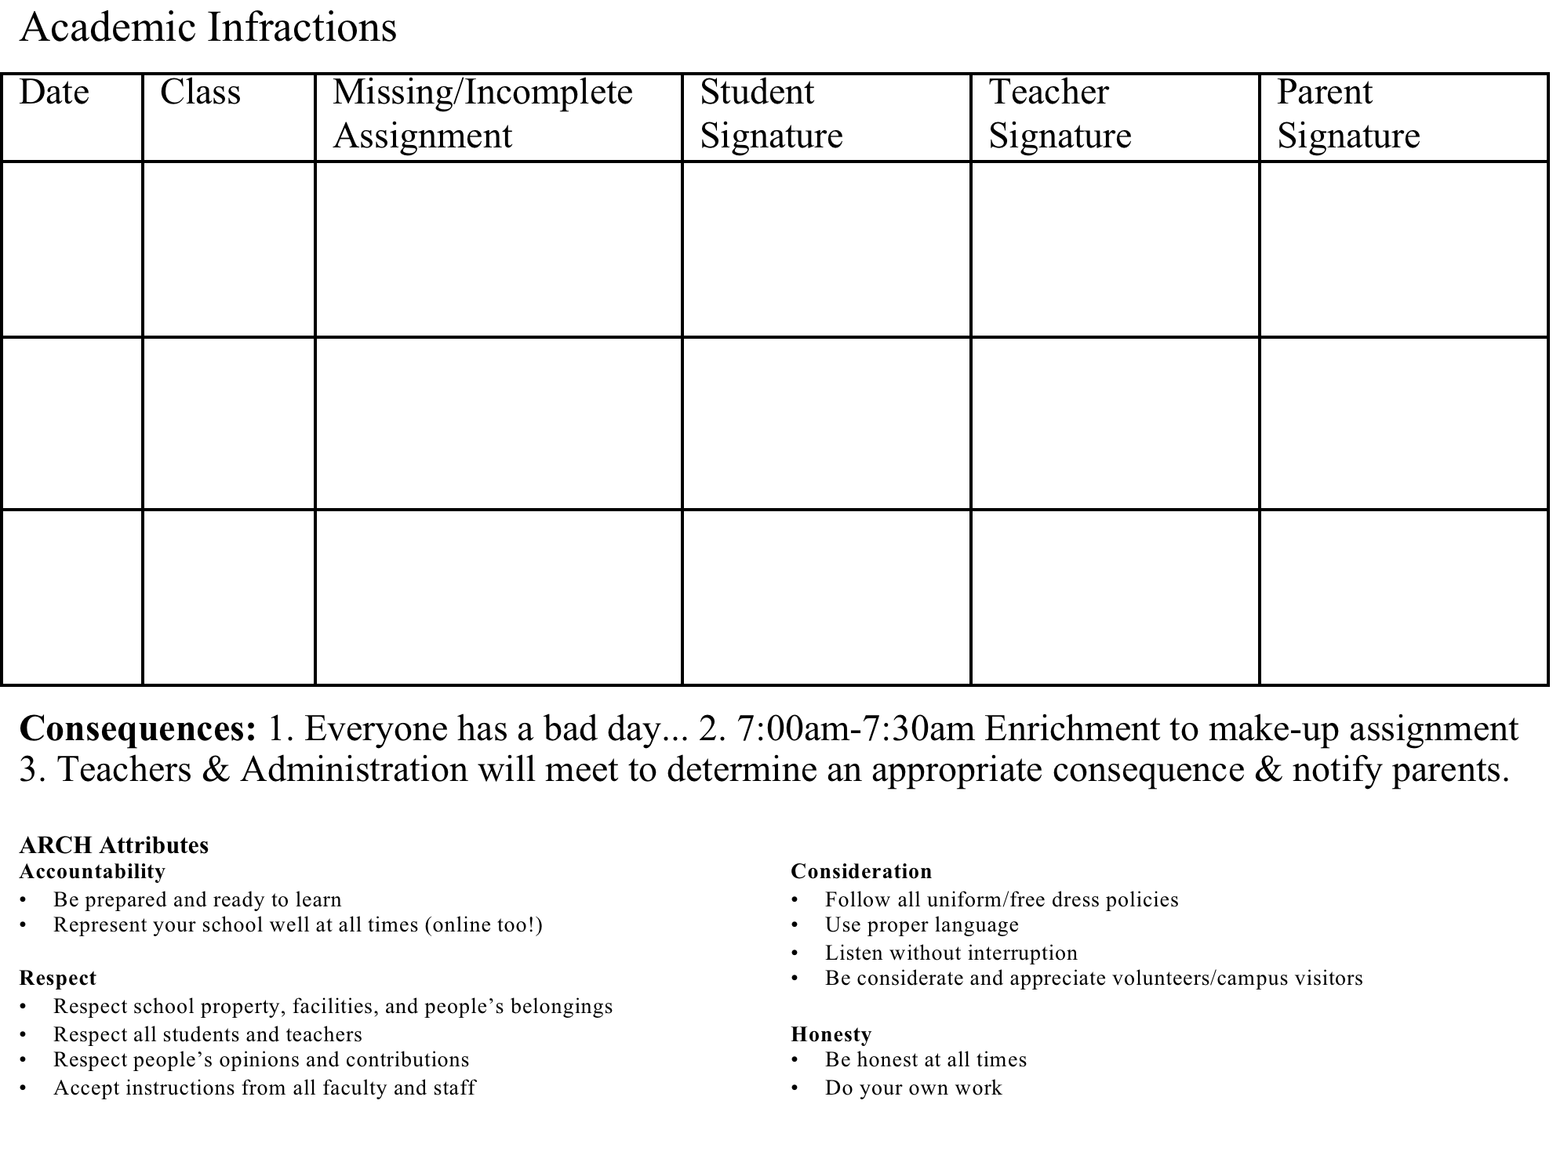
Back of Card

Slide 14
CONFIRMATION
SATURDAY, JUNE 3,2017
12 NOON

Slide 15
GKTW
We are committed to GKTW for the entire year including summers. We go on the FIRST FRIDAY of every month from 5:30-8:30. In addition to student volunteers, I also need parents.
If your child is planning to volunteer for GKTW, he/she must complete the online application ASAP. You must also complete a parental agreement for your child.
If you want to participate, you must complete an online application and a background check.
All of the necessary information is on my website http://fosterkat.com.

Slide 16
Next GKTW is Friday, September 2.
Please email me if you/your child want to participate or have your child sign up when I pass around the sign up sheet-
20 Junior High Students and at least 5 adults.

Slide 17
REDIKER/PLUS PORTALS
Make sure you are signed up.
Email changes must be made through REDIKER
Parents can have multiple accounts
Email/call or see our Technology Coordinator for all Rediker issues
Make sure you use an email address that you check regularly

Slide 18
REDIKER
Points to Observe and other important school info comes via REDIKER
Weekly emails from me
Other emails from Junior High teachers
Progress Reports

Slide 19
MY WEBSITE
http://fosterkat.com

Slide 20
ABSENCES:
When a student is absent parents MUST CALL the office that morning
AND
SEND IN A NOTE THE NEXT DAY with the absence excuse.

Slide 22
Lockers
The students MAY HAVE SHELVES in their lockers.
They MAY NOT DECORATE THEIR LOCKERS IN ANY OTHER WAY-mirrors, chandeliers, wall paper, pictures of the One Direction guys, etc.

Slide 23
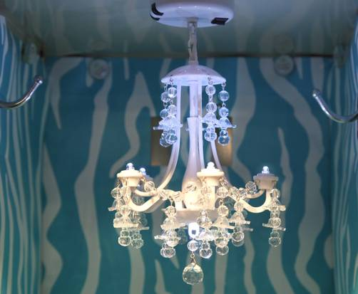
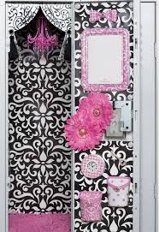
NO!!!!

Slide 24
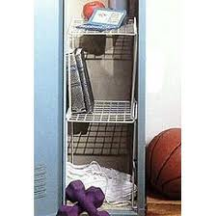
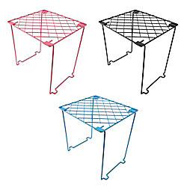
YES!!!!

Slide 25
GRADE 7 AND 8 SUMMER READING PACKET TURNED IN TO SCHOOLOGY BY FRIDAY, AUGUST 19. IF DONE ON AN iPad or other iDevice, TURN IT IN AS A PDF OR WORD DOCUMENT.
SUMMER WRITING FOLDER BROUGHT TO SCHOOL BY FRIDAY, AUGUST 19.

Slide 26
DISMISSAL AND ARRIVAL
The new dismissal time for 2016-2017 is 3 PM. Afternoon prayer and announcements will be done at 2:55 and EPass and first call ALPHA students will be dismissed. Doors will open at 3 PM for regular dismissal until 3:20. After 3:20, your children in grades K-8 will be taken to ALPHA. Preschool ALPHA will stay in the classroom until 4:30 pm.
Most Thursdays, we will dismiss at 2:10 and final call for ALPHA will be at 2:30 pm.
There will be no early dismissal from 2:30-3:00 pm this year and a note or email must be sent to the teacher and school office to notify us ahead of time for all early dismissals.
All students must be in the classroom by 7:45. If you arrive after 7:45, please accompany your child into school and sign them in at the front office. They will be marked tardy for the day.

Slide 27
WELCOME
TO THE
WORLD OF
ENGLISH

Slide 28
SEVENTH GRADE
CURRICULUM

Slide 29
LITERATURE
GRAMMAR
CAPTALIZATION
PUNCTUATION
SENTENCE STRUCTURE

Slide 30
PARTS OF SPEECH
USAGE
DIAGRAMMING

Slide 31
In Literature, we will study several novels and a Shakespeare play. We will also have a Short Story Unit and Poetry Unit. We will be using a new and different approach to the study of vocabulary.

Slide 32
DAILY ROUTINE

Slide 33
Monday: copy homework
Tuesday: Word of the Day
Wednesday: Social Media Slip-ups
Thursday: Figurative Language Identification
Friday: Go over homework

Slide 34
WRITING
USING THE WRITING PROCESS,
STUDENT’S CHOOSE A TOPIC,
BRAINSTORM WITH THINKING MAPS, PREWRITE, REVISE, EDIT,
AND WRITE A FINAL COPY.

Slide 35
WEEKLY WRITING ASSIGNMENT
DESCRIPTION/ NARRATIVE
PROCESS
CLASSIFICATION

Slide 36
COMPARISON/CONTRAST
ARGUMENT
DEFINITION

Slide 37
EIGHTH GRADE
CURRICULUM

Slide 38
Grammar
Writing
Literature

Slide 39
Grammar- a review of
Punctuation
Capitalization
Usage
Sentence Structure
Phrases/ Clauses

Slide 40
Literature:
Short Story Unit
The Giver by Lois Lowry
A Midsummer Night’s Dream by William Shakespeare
Witness by Karen Hesse,
A Holocaust unit- Prisoner B-3087
Throughout the year, we will be reading and analyzing non-fiction books and articles.
Throughout the year we will also be exploring poetry.

Slide 41
Writing:
Narrative
Persuasive
Expository
Literary Analysis
Poetry
MGRP

Slide 42
7th and 8th GRADE ENGLISH HOMEWORK IS ASSIGNED ON MONDAY AND IS DUE FRIDAY. EIGHTH GRADE ALSO HAS LITERATURE HOMEWORK.

Slide 43
AFTER SCHOOL HELP
MONDAYS AND WEDNESDAYS FROM DISMISSAL UNTIL 4:15 P.M.

Slide 44
My Policies and Procedures handout will be given to the students THE FIRST WEEK OF SCHOOL -signed and returned by Friday, August 19.

Slide 45
ALL JUNIOR HIGH FORMS ARE POSTED ON MY WEBSITE.

Slide 46

Middle School Religion
7th & 8th Grade Parent Meeting
Notes:
For those of you ho do not know me, my name is Sharon Taylor. I will be teaching your children Religion this year

Slide 47
Mrs. Taylor
Junior Hi Religion at SJV
Sacramental Coordinator at Holy Cross
Diocesan Instructor to EMHCs, member of the Liturgical Conference Committee
Notes:
I also am the Sacramental Coordinator at Holy Cross and teach for the Diocese of Orlando – what I do for fun is teach your students.

Slide 48
WORK HARD
As in all subjects, standards are high in Religion, as well.
What is taught in other disciplines is to be applied in all – that’s why we teach. ☺
Essay questions are to in paragraph form, in complete sentences.
All assignments are to be well thought, neat and well organized
Notes:
When it come to Chapter tests a few poorly written phrases will not be an acceptable response to an essay question. Capitalization and punctuation matter too

Slide 49
FAITH SHARING
We want to share our Catholic Faith with each other.
We also want to share the different faiths God has brought to SJV.
Understanding fosters peace!
Notes:
We share our faith through writing, table discussions and large group discussions.

Slide 50
WE PRAY
+ Rosary
+ Stations of the Cross
+ Guided Meditations
+ Lectio Divina
+ Adoration
+ Silent prayer
+ Communal Prayer

Slide 51
CLASS
Class on Monday, Tuesday, Thursday & Friday
Mass on Wednesday

Slide 52
TEXTBOOKS
We Live our Faith
Breakthrough Bible
Decision Making
YOUCAT
Family Life
Books & Bibles are kept in class unless needed

Slide 53
GRADES
Usually high
Class participation matters! This means sharing ideas that are relevant to topic!
Notes:
For some students class participation is more of a challenge. One cannot score well on class participation if always quiet. Nor will they always be sitting next to people they want to talk to. At work, we are often called to collaborate with those who are not friends.

Slide 54
HOMEWORK
There is some homework
Trimester projects
Holy Day assignments

Slide 55
PROJECTS
Sacraments
Salt Flour Map
Saint Project
Christmas
Holy Week
Gospel of the Year
Morality Essay
Notes:
These assignments will always be scheduled several weeks in advance and are expected when due. Christmas and Holy Week are not so much projects as much as reflection papers, but completion will require attendance at a religious service.

Slide 56

OUTREACH
Cards for Nursing Home &
Shut Ins
Bag Lunches for homeless- please send what you can – no pressure
Bag Lunches include Scripture and messages
of hope.

Slide 57

FRIENDS OF FRANCIS
To prepare lunches we need:
- Bread
- Lunch meat
- Mustard
- Mayonnaise
- Peanut butter
- Chips
- Cookies

Slide 58

GROWTH
We all grow in faith, love and hope!

Slide 59
Junior High math

Slide 60
Welcome to Junior High math
Dr. Causey
Bachelor of Arts Degree – Stetson University
History and Mathematics
Master of Education Degree – University of Central Florida
Mathematics Education
Doctorate - University of Central Florida
Mathematics Curriculum and Instruction
Teaching Experience: 38 years teaching grades 9 – 12 (Pre-Algebra through Advanced Placement Statistics)
20 years teaching undergraduate, Masters and Doctoral classes at the University of Central Florida

Slide 61
Textbooks
The students are to BRING their math textbook To class every day to work on assignments.

Slide 62
7th Grade Math

Slide 63
Course Content for 7th Grade
All operations of whole numbers, decimals, and fractions
Number Theory facts
Percentage and consumer math topics
Algebraic expressions
Equations and inequalities
Order of operations
Absolute value
Computation with integers
Squares and square roots
Ratio and proportion
Exponents, powers of ten, and scientific notation
Polynomials
Perimeter, area, surface area, volume
Constructions with compass
Pythagorean Theorem
Graphing
Measures of central tendency
Permutations and combinations
Dependent and independent events
We will begin the year using problem solving
methods as we work with real world application problems.

Slide 64
Pre-Algebra

Slide 65
Course Content for Pre-Algebra
Algebraic Expressions
Properties
Relations with Ordered Pairs
Integers and all Operations
Absolute Value
Solving Equations
Powers and Exponents
Operations with Monomials
Fraction and Decimal Review
Ratio, Percent and Proportion Review
Solving Linear Equations and Inequalities
Functions
Slope
Graphing Equations
Squares and Square Roots
Real Number System
Pythagorean Theorem
Polynomials
We will begin the year working with
number properties, coordinate graphing and linear relationships.

Slide 66

Algebra

Slide 67
Course Content for Algebra
Real and Complex Number Systems
Functions
Linear Equations and Inequalities
Polynomials
Rational Expressions and Equations
Radical Expressions and Equations
Quadratic Equations
Exponential Functions
We will begin the year with functions and linear equations.

Slide 68
Need Help ???
I am available for after school tutoring.
Questions will also be addressed each day in class.
Do not let questions remain unresolved. The secret to understanding math is to ask about any process that is unclear so that today’s knowledge can be built upon.
I look forward to sharing my love of math
with each and every student.

Slide 69


Welcome…
Ms. Robin DeVito
7th Grade Life Science
8th Grade Physical Science

Slide 70
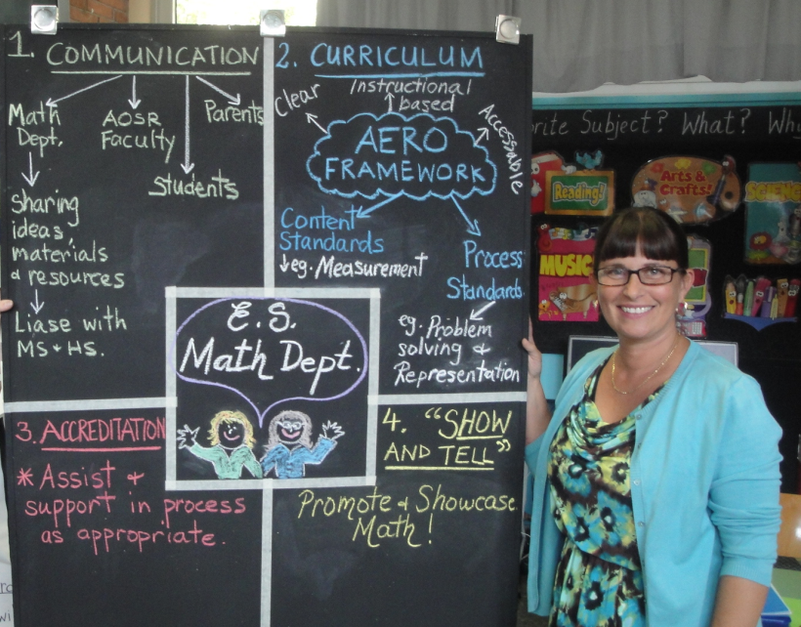

About me
Grew up in Orlando; graduated from Boone HS
Married, 3 kids (10th, 12th at LNHS, oldest at UCF)
Education: UCF,APSU (B.S. Distributive Biology, M.A. Education)
20+ years teaching; across US and Europe
Fourth year at SJVS

Slide 71


Jr. High Science
I post all assignments/info to Rediker
7th Grade 8th Grade

Slide 72

STEM Portal
#ScienceRocks
www.theSTEMportal.com
Kid friendly, supplementary resource (cool videos, recent scientific developments, etc.)
Does not require student to have social media accounts
Intent is to share exciting opportunities and developments in the STEM related fields of Science, Technology, Engineering and Math
I encourage you to explore the Portal with your student, and I invite you to forward to me amazing STEM content that your student finds interesting

Slide 73
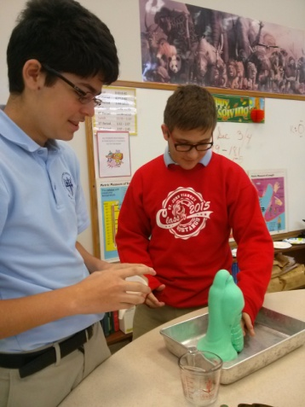
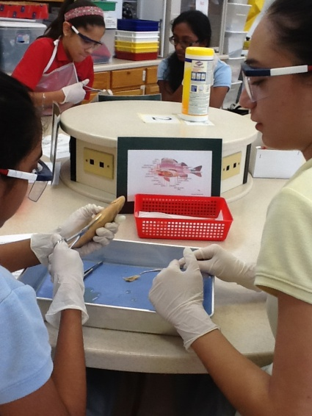
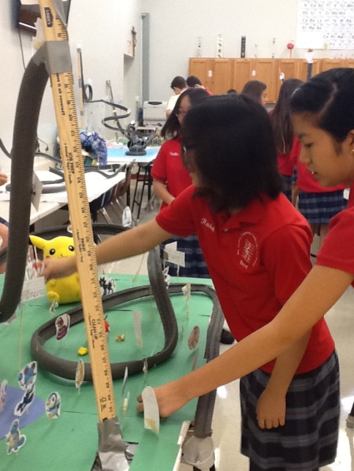
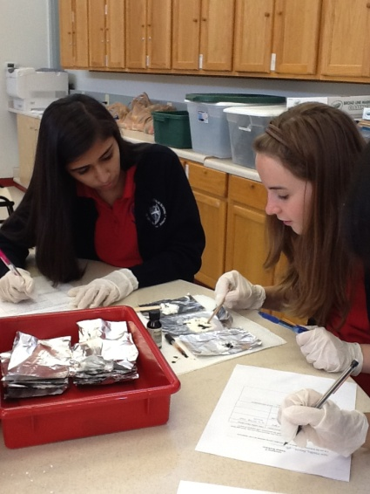
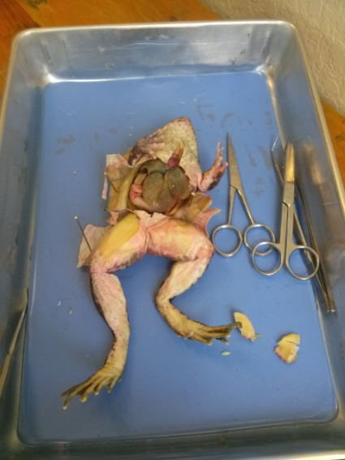
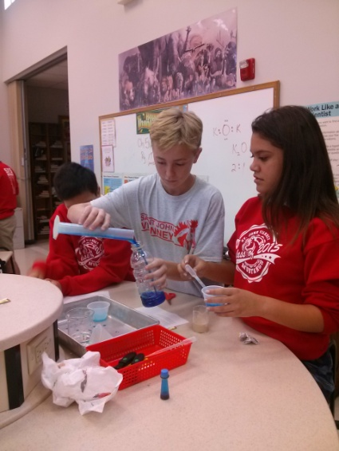
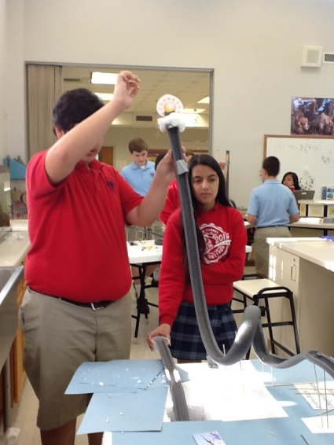
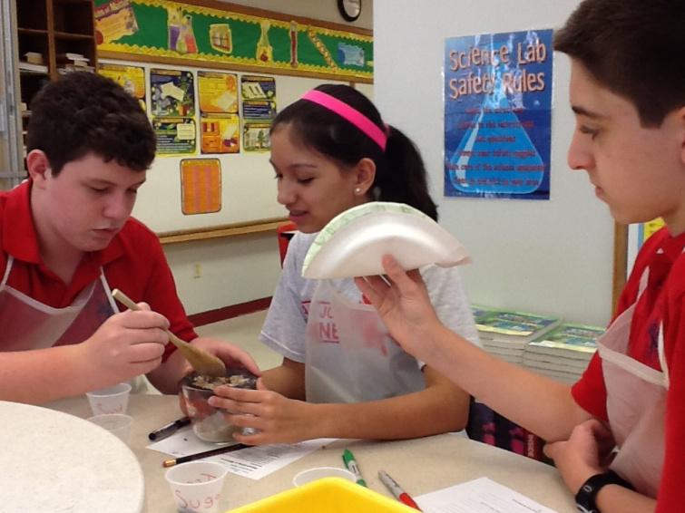
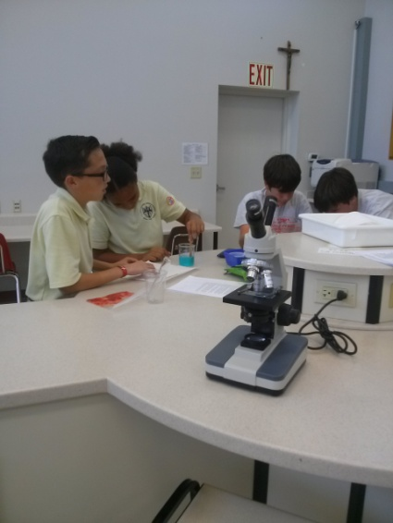
Labs

Slide 74
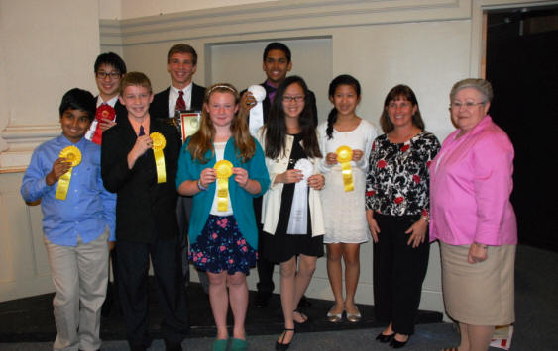
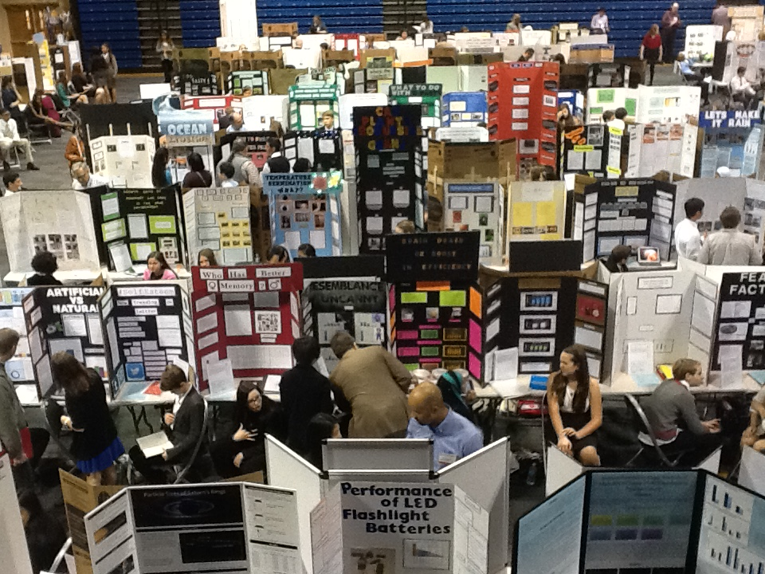
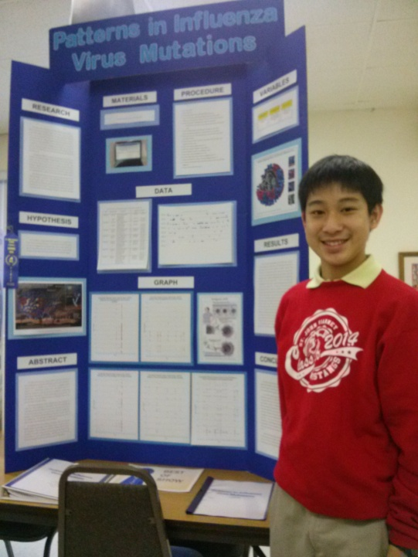
Science Fair
SJVS
Ying Expo
State

Slide 75
Contact Information…
Ms. Robin DeVito
devitor@sjvs.org

Slide 76
Social Studies
Ms. Danisovszky
(Dan-uh-show-ski)
B.S. Social Science Education,
University of Central Florida
Florida Teacher Certification:
Social Science 6-12

Slide 77
Junior High Social Studies
Current Events
Tests, Quizzes, & Projects
Classwork & Homework
Participation…SOCIAL studies

Slide 78
8th Grade U.S. History
Textbook: Discovering our Past: A History of the United States Early Years, McGraw-Hill, 2013
Survey of United States History from Colonial America through Reconstruction (1600-1890)
  Thirteen Colonies
  American Revolution
  Founding Documents
  Westward Expansion
  Civil War
  Reconstruction

Slide 79
7th Grade Civics
Textbook: Civics, Economics, & Geography,
McGraw-Hill, 2013
U.S. Regions, major landforms and major landmarks
An overview of National, State and Local government in the United States
Types of governments and economic systems
Types of economic systems
Exploration of landmark Supreme Court cases

Slide 80
Art History (8th Grade)
Focus on Critical Thinking and Analysis
Explore Art Movements
Learn about Famous Artists & their works

Slide 81
National Junior Honor Society
More information will be sent home via backpack
and email in the next few weeks!

Slide 82
THE CAT YEARS

Slide 83


The Cat Years
I just realized that while children are dogs--loyal and affectionate--teenagers are cats. It's so easy to be a dog owner. You feed it, train it, boss it around. It puts its head on your knee and gazes at you as if you were a Rembrandt painting. It bounds indoors with enthusiasm when you call it.

Slide 84

Then, around age 13, your adoring little puppy turns into a big old cat. When you tell it to come inside, it looks amazed, as if wondering who died and made you emperor. Instead of dogging your footsteps, it disappears. You won't see it again until it gets hungry--then it pauses on its sprint through the kitchen long enough to turn its nose up at whatever you're serving. When you reach out to ruffle its head, in that old affectionate gesture, it twists away from you, then gives you a blank stare, as if trying to remember where it has seen you before.

Slide 85

You, not realizing that the dog is now a cat, think something must be desperately wrong with it. It seems so antisocial, so distant, sort of depressed. It won't go on family outings.
Since you're the one who raised it, taught it to fetch and stay and sit on command, you assume that you did something wrong. Flooded with guilt and fear, your redouble your efforts to make your pet behave.
Only now you're dealing with a cat, so everything that worked before now produces the opposite of the desired result. Call it, and it runs away. Tell it to sit, and it jumps on the counter. The more you go toward it, wringing your hands, the more it moves away.

Slide 86

Instead of continuing to act like a dog owner, you can learn to behave like a cat owner. Put a dish of food near the door, and let it come to you. But remember that a cat needs your help and your affection too. Sit still, and it will come, seeking that warm, comforting lap it has not entirely forgotten. Be there to open the door for it. One day, your grown-up child will walk into the kitchen, give you a big kiss and say, "You've been on your feet all day. Let me get those dishes for you." Then you'll realize your cat is a dog again.

Slide 87
WE NEED HELP PUTTING AWAY THE CHAIRS, PLEASE!!!!

